Slide 1
TSU
Master degree Student of nuclear medicine physics :
Nino Batselashvili Practicing medical physics at RICM
(Todua clinic)
supervisors: Medical physicist/PhD Beka Bochorishvili Prof. Revaz Shanidze

Slide 2
Teletheraphy treatment planning

Slide 3
Contents :
External Beam Therapy
linear Accelerator
Planning Radiation Therapy
CT-simulation and 3D conformal (IMRT, VMAT)
Treatment delivery

Slide 4
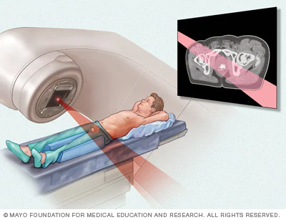
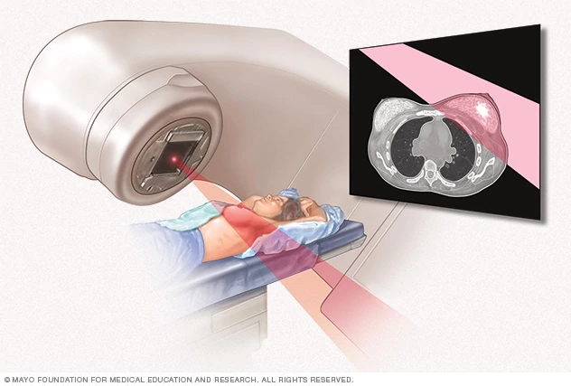
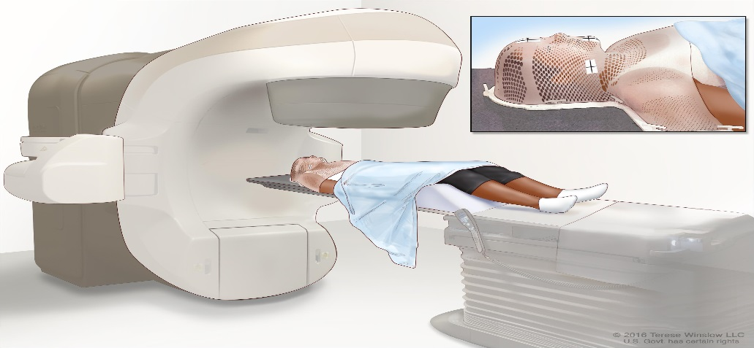
Radiation Therapy is used to….
Breast Cancer Treatment
Colorectal (Bowel) Cancer Treatment
Esophageal Cancer Treatment
Head and Neck Cancer Treatment
Lung Cancer Treatment
Prostate Cancer Treatment
Brain Tumor Treatment

Slide 5
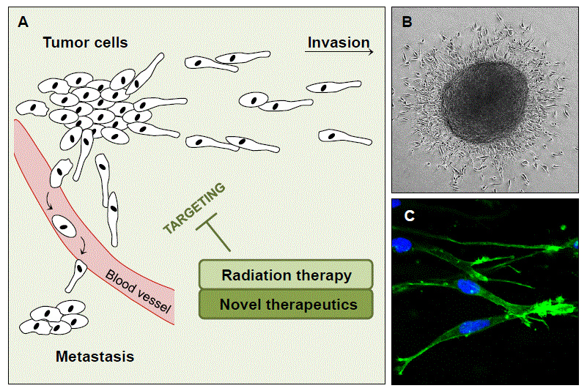
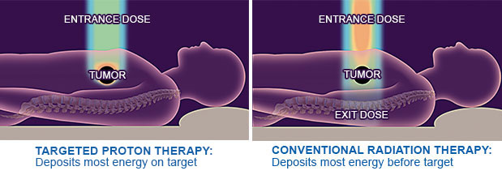
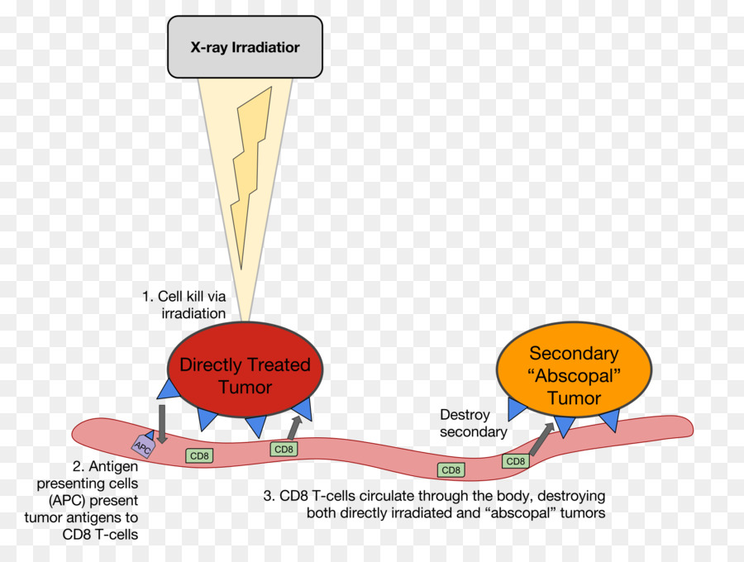
E B T

Slide 6
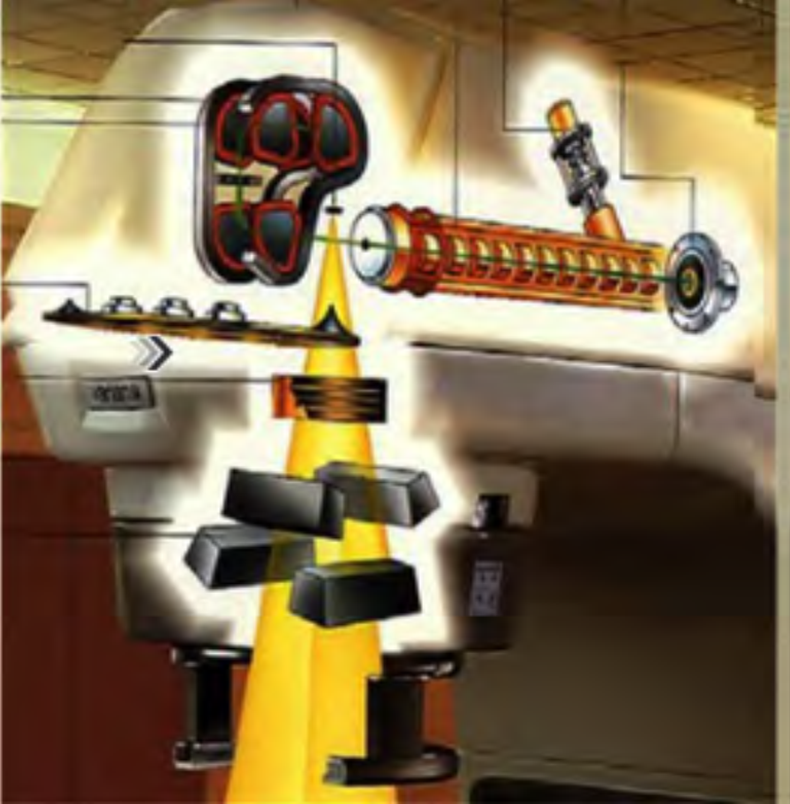
Linear Accelerator
The linear accelerator (Linac), uses microwave technology to accelerate electrons in a part of the linac called waveguide, then allows these electrons to collide with a heavy metal target. As a result of these collisions, high energy X-Rays (Photons) are produced from the target. This is the most common device to treat cancer with external beam radiation.

Slide 7
Gantry, Couch and Multi leaf Collimators
Gantry: A frame housing the x-ray tube, collimators, and detectors in a CT or radiation therapy machine, with a large opening into which the patient is inserted; a mechanical support for mounting a device to be moved in a circular path. MLC’s: They are heavy metal field-shaping devices with independent moving mechanisms used to create a custom like block to spare normal tissue and direct the radiation dose to the tumor.

Slide 8
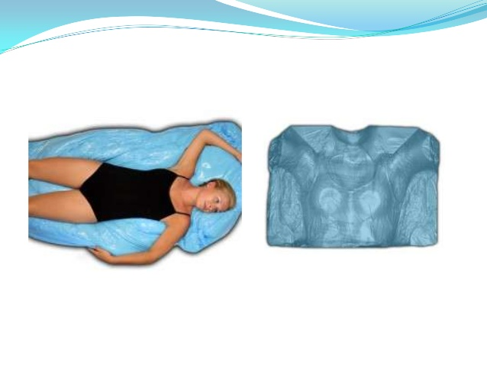
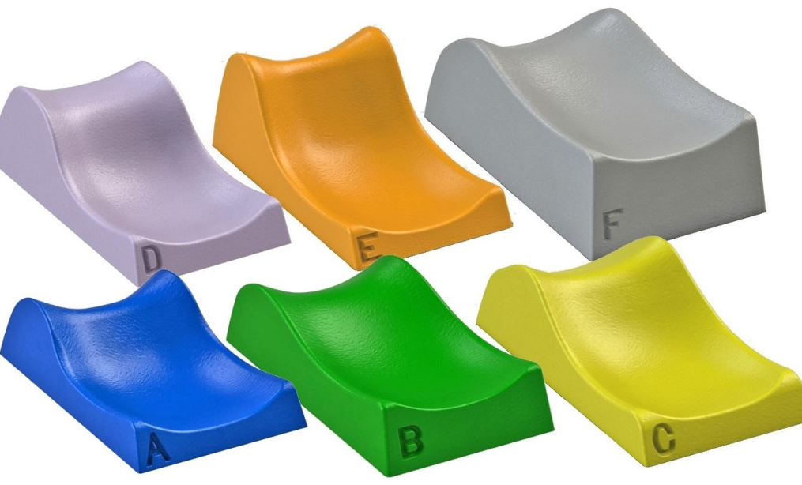
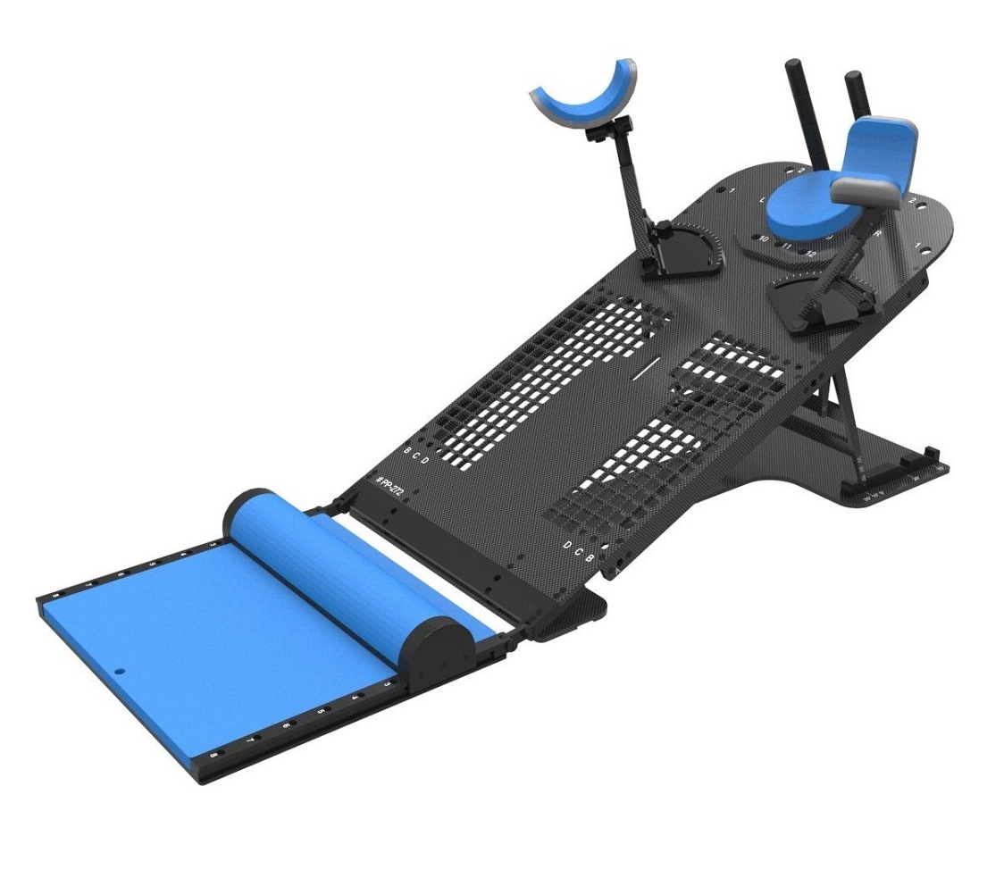
Radiotherapy Treatment Planning System
Masks, pads or other immobilization devices are typically used to help the patient to hold still and in a specific position during the simulation.

Slide 9
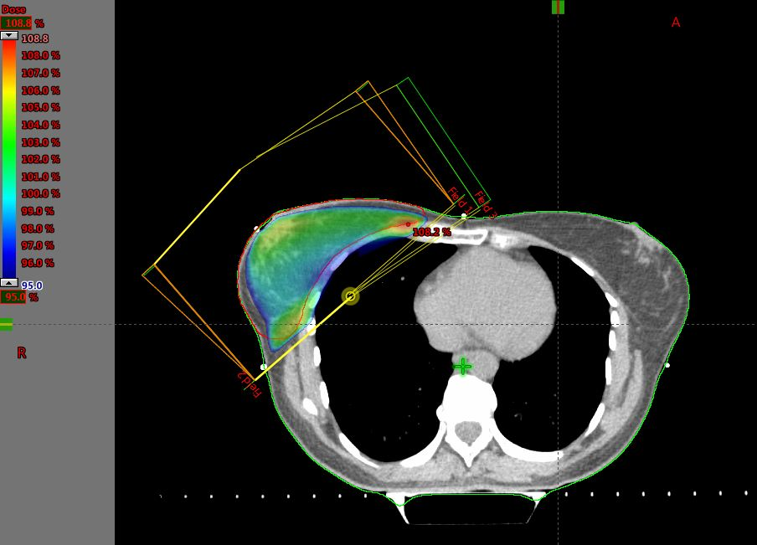
Radiotherapy Treatment Planning
The LINAC is used to treat all body sites, using conventional techniques, Intensity-Modulated Radiation Therapy (IMRT), Volumetric Modulated Arc Therapy (VMAT)

Slide 10
3D conformal radiation therapy is a cancer treatment that shapes the radiation beams to match the shape of the tumor.
The radiologist will take a 3D image of patient’s tumor, often using one of the following imaging methods:
CT (computed tomography) scan.
MRI (magnetic resonance imaging).
PET (positron emission tomography) scan.
PET-CT scan.
Then, a computer program analyzes the 3D image and designs radiation beams that conform to the shape of the tumor.

Slide 12
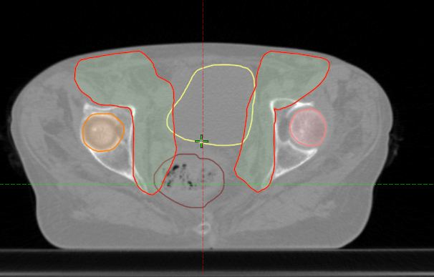
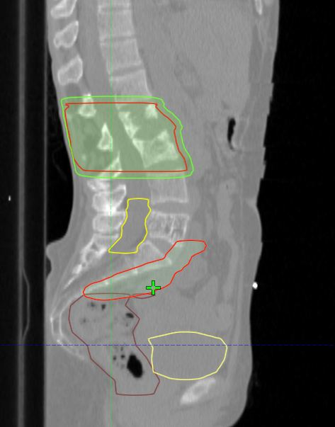
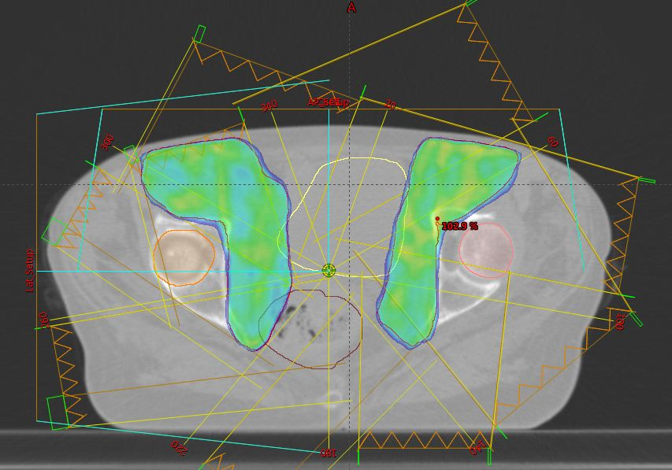
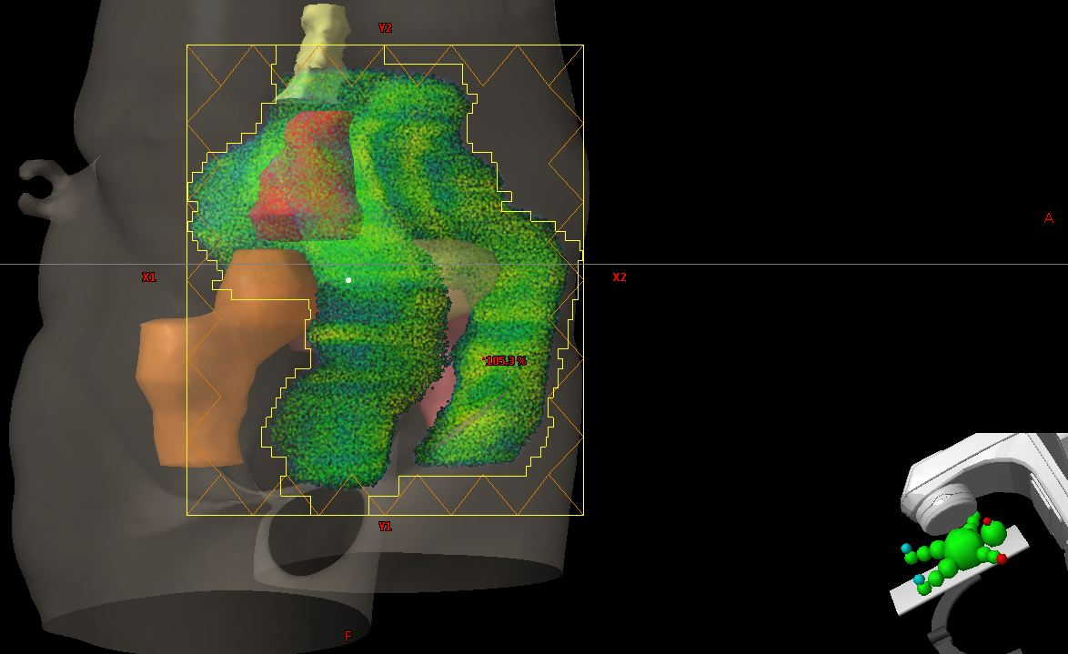

Slide 13
(I M R T)
Intensity-modulated radiotherapy (IMRT) uses linear accelerators to safely and painlessly deliver precise radiation doses to a tumor while minimizing the dose to surrounding normal tissue. Cancer is irradiate from the different angels of beam.

Slide 14
(V M A T)
Volumetric Arc Therapy (VMAT) is an advanced form of intensity-modulated radiotherapy, when the machine is moved around the patient , changed beam shape and treatment dose automatically.

Slide 15
In most cases the total dose of radiation needed to kill a tumor can’t be given all at once. This is because a large dose given one time can cause more damage to nearby normal tissues. This can cause more side effects than giving the same dose over spread out into many treatments. The total dose of external radiation therapy is usually divided into smaller doses called fractions. Most patients get radiation treatments daily, 5 days a week , for 5 to 8 weeks. Weekend rest breaks allow time for normal cells to recover. The total dose of radiation and the number of treatments is based on:
The size and location of the cancer
The type of cancer
The reason for the treatment
patients general health

Slide 16
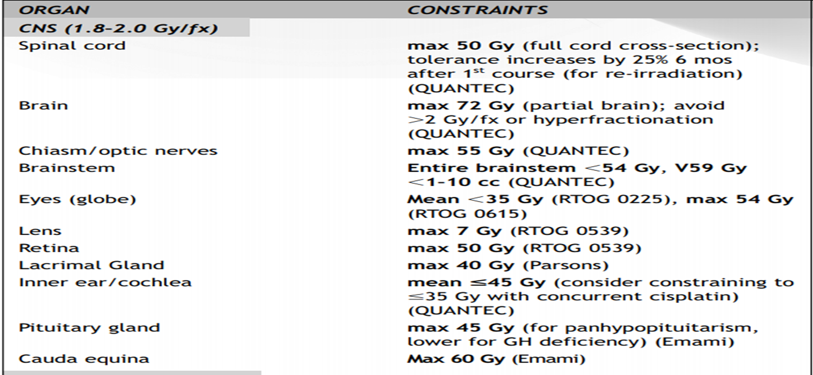
Consraints of Dose

Slide 17
After the simulation and planning have been completed, the treatment can begin.

Slide 18
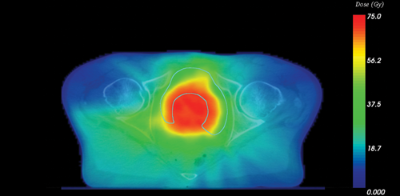
Important => make a good plane

Slide 19
Patient safety is very important and is assured in several ways.
Before treatment is delivered to the patient, a treatment plan is developed and approved by the radiation oncologist in collaboration with the radiation dosimetrist and medical physicist. The plan is double-checked before treatment is given and quality-assurance procedures are performed to ensure that the treatment will be delivered as planned.

Slide 20
Thanks for your attention!

